Slide 1
TrigonoMetry and Calculators
10/13/2017

Slide 2
One Minute Question
A spider is 2 feet from the center of a ceiling fan with blades that reach 3 feet from the center. If the fan makes 5 revolutions in 4 seconds, what is the linear velocity of the spider?

Slide 3
A spider is 2 feet from the center of a ceiling fan with blades that reach 3 feet from the center. If the fan makes 5 revolutions in 4 seconds, what is the linear velocity of the spider?
Its angular velocity is 5/4 rev/sec and since he travels 4 feet in revolution:
V =

Slide 4
Calculator Questions:
What are these values?
Cos 127º
$sin\frac{5π}{9}$
Tan 8

Slide 5
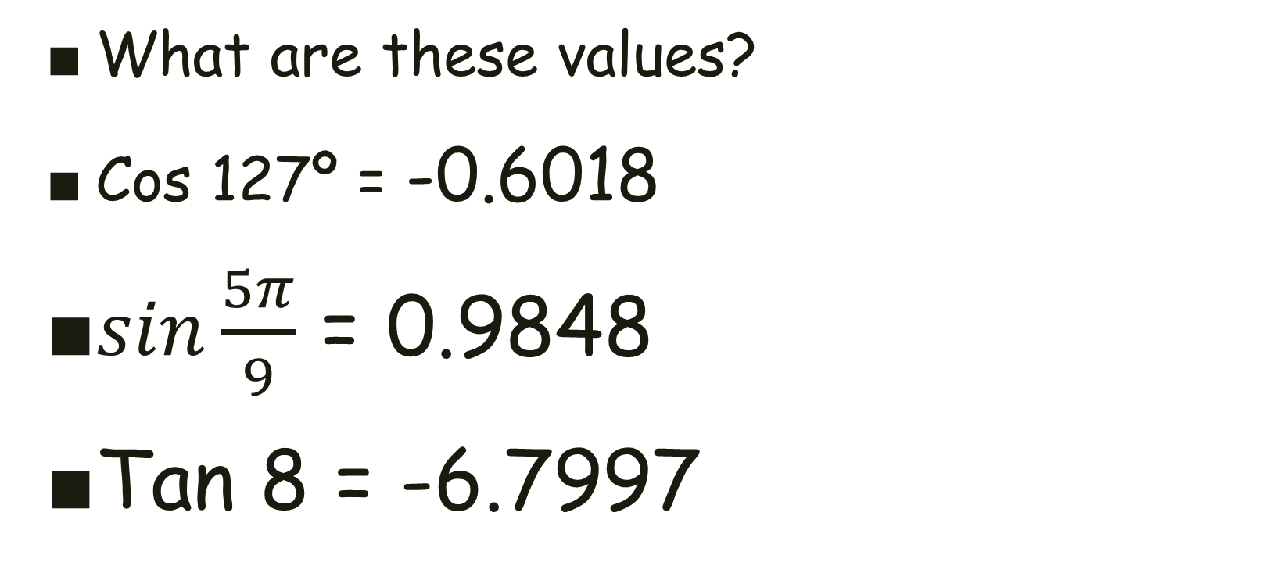
Calculator Questions:
What are these values?
Cos 127º = -0.6018
$sin\frac{5π}{9}$ = 0.9848
Tan 8 = -6.7997

Slide 6
Calculator Questions:
If cos θ = 0.1538, what is θ ?
What is another value for θ ?
Name all the possible values for θ between 0º and 360º.
Name all the possible values for θ between 0 and 2π.

Slide 7
Calculator Questions:
If cos θ = 0.1538, what is θ ? 81.15°
What is another value for θ ? 278.85°
Name all the possible values for θ between 0º and 360º. Only these 2.
Name all the possible values for θ between 0 and 2π. 1.416 and 4.8668

Slide 8
Calculator Questions:
Compare and Contrast these problems.
If sin θ = 0.1538, what is θ ?
What is another value for θ ?
Name all the possible values for θ between 0º and 360º.
Name all the possible values for θ between 0 and 2π.

Slide 9
Calculator Questions:
If sin θ = 0.1538, what is θ ? 8.847°
What is another value for θ ? 171.15°
Name all the possible values for θ between 0º and 360º. Only these 2.
Name all the possible values for θ between 0 and 2π. 0.1544 and 2.987

Slide 10
Calculator Questions:
Compare and Contrast these problems.
The second cosine angle was found by subtracting the calculator value (reference angle) from 360°.
The second sine angle was found by subtracting the calculator value (reference angle) from 180°.

Slide 11
Calculator Questions:
Compare and Contrast these problems.
If tan θ = 0.1538, what is θ ?
What is another value for θ ?
Name all the possible values for θ between 0º and 360º.
Name all the possible values for θ between 0 and 2π.

Slide 12
Calculator Questions:
If tan θ = 0.1538, what is θ ? 8.7436°
What is another value for θ ? 188.744°
Name all the possible values for θ between 0º and 360º. Just these 2…
Name all the possible values for θ between 0 and 2π. 0.1526 and 3.294

Slide 13
Calculator Questions:
Compare and Contrast these problems.
To find the other angle for a tangent, just add 180°.

Slide 14
Calculator Questions:
If cos θ = -0.5381, what is θ ?
What is another value for θ ?
Name all the possible values for θ between 0 and 2π.

Slide 15
Calculator Questions:
If cos θ = -0.5381, what is θ ? 122.55°
What is another value for θ ? 237.45 °
Name all the possible values for θ between 0 and 2π.
2.139 and 4.144

Slide 16
Calculator Questions:
Compare and Contrast these problems.
If sin θ = -0.5381, what is θ ?
What is another value for θ ?
Name all the possible values for θ between 0 and 2π.

Slide 17
Calculator Questions:
If sin θ = -0.5381, what is θ ? 327.45°
What is another value for θ ? 212.55°
Name all the possible values for θ between 0 and 2π.
3.7098 and 5.715

Slide 18
Calculator Questions:
Compare and Contrast these problems.
The second angle for a given cosine value can still be found by subtracting the calculator’s angle (not the reference angle this time) from 360°.
The second angle for the given sine value can still be found by subtracting the calculator’s angle (the opposite of the reference angle) from 180°.

Slide 19
Calculator Questions:
Compare and Contrast these problems.
If tan θ = -01.538, what is θ ?
What is another value for θ ?
Name all the possible values for θ between 0 and 2π.

Slide 20
Calculator Questions:
If tan θ = -01.538, what is θ ? 123.03°
What is another value for θ ? 303.03°
Name all the possible values for θ between 0 and 2π.
2.1473 and 5.2889

Slide 21
Calculator Questions:
Compare and Contrast these problems.
The second angle for a given tangent value can still be found by adding 180° to the calculator’s value.

Slide 22
Calculator Questions:
If sec θ = 2.576, name all the possible values for θ between 0º and 360º.
If csc θ =-3.142, name all the possible values for θ between 0 and 2π.

Slide 23
Calculator Questions:
If sec θ = 2.576, name all the possible values for θ between 0º and 360º. 67.157º and 292.84º
If csc θ =-3.142, name all the possible values for θ between 0 and 2π. 3.466 and 5.959

Slide 24
Calculator Questions:
If cot θ = 0.1538, name all the possible values for θ between 0º and 360º.
If cot θ = -2.154, name all the possible values for θ between 0 and 2π.
Compare and Contrast these problems.

Slide 25
Calculator Questions:
If cot θ = 0.1538, name all the possible values for θ between 0º and 360º. 81.256º and 261.256º
If cot θ = -2.154, name all the possible values for θ between 0 and 2π. 2.7069 and 5.8485

Slide 26
Calculator Questions:
Compare and Contrast these problems.
When finding the next cotangent angle in degrees, add 180º to the calculator’s value.
When finding the next cotangent angle in degrees, add π to the calculator’s value.

Slide 27
Calculator Questions:
The angle of elevation from a point on the ground 30’ from the base of a tree to the top of a tree is 62º. How tall is the tree?

Slide 28
Calculator Questions:
The angle of elevation from a point on the ground 30’ from the base of a tree to the top of a tree is 62º. How tall is the tree?
tan 62º = h/30, so
30’ h = 56.42 feet
62º

Slide 29
Calculator Questions:
The angle of depression from the top of a lighthouse to a boat in distress is 28º18’. If the lighthouse is 63’ above sea level, how far from the lighthouse is the boat?

Slide 30
Calculator Questions:
The angle of depression from the top of a lighthouse to a boat in distress is 28º18’. If the lighthouse is 63’ above sea level, how far from the lighthouse is the boat?
28º18’ tan 28º18’ = 63’/x so
x = 63’/ tan 28º18’ =
117 feet

Slide 31
Calculator Questions:
The angle of elevation to top of a building is 58º18’. If there is a 30’ flagpole atop the building and the angle of elevation to it is 62º43’, how tall is the building?

Slide 32
Calculator Questions:
The angle of elevation to top of a building is 58º18’. If there is a 30’ flagpole atop the building and the angle of elevation to it is 62º43’, how tall is the building?
30’ tan 58º18’ = h/d
tan 62º43’ = (h+30)/d
h h/tan 58º18’ = (h+30)/tan 62º43’
h = 151.93’

