Slide 1
Geometric Sequences
Accelerated Precalculus
4/26/2019

Slide 2
One Minute Question
Consider the sequence: t_{n} = {3, 6, 12, 24, …}
What is the ratio of t₁₃/t₁₁ ?
t₁₃/t₁₁ = t₃/t₁ = 12/3 = 4

Slide 3
One Minute Question
Consider the sequence: t_{n} = {3, 6, 12, 24, …}
This is a geometric sequence because it has a common ratio.
A geometric sequence is a subset of what type of function?
Exponential

Slide 4
One Minute Question
Consider the sequence: t_{n} = {3, 6, 12, 24, …}
What is the n^{th} term of t_{n}?
t_{n} = 3(2)^{n-1} =(3/2)2^{n}

Slide 5
New problem
Consider the sequence:
g_{n} = {500, -100, 20, -4, …}
What is the n^{th} term of g_{n}?
g_{n} =500(-1/5)^{n-1} = -2500(-1/5)^{n} = -2500/(-5)^{n}
Compare and contrast t_{n} and g_{n.}
t_{n} increases but |g_{n}| decreases.
g_{n} alternates signs.

Slide 6
Definitions
Increasing sequences increase.
Decreasing sequences decrease.
Alternating sequences alternate signs.

Slide 7
Series
Think about the sum of a geometric series:
S_{n} = t₁ + t₁r + t₁r² + t₁r³ + t₁r⁴ + … + t₁r^{n-2} + t₁r^{n-1}
rS_{n} = t₁r + t₁r² + t₁r³ + t₁r⁴ + t₁r⁵… + t₁r^{n-1} + t₁r^{n}
Subtract and get:
S_{n} – rS_{n}= t₁ – t₁r^{n}
S_{n} (1 – r)= t₁ – t₁r^{n}
So S_{n} = (t₁ – t₁r^{n})/(1 – r)

Slide 8
Infinite Series
Add these:
1 + 2 + 3 + …
8 + 6 + 4 + 2 + …
3 + 6 + 12 + …
500 – 100 + 20 – 4 + …

Slide 9
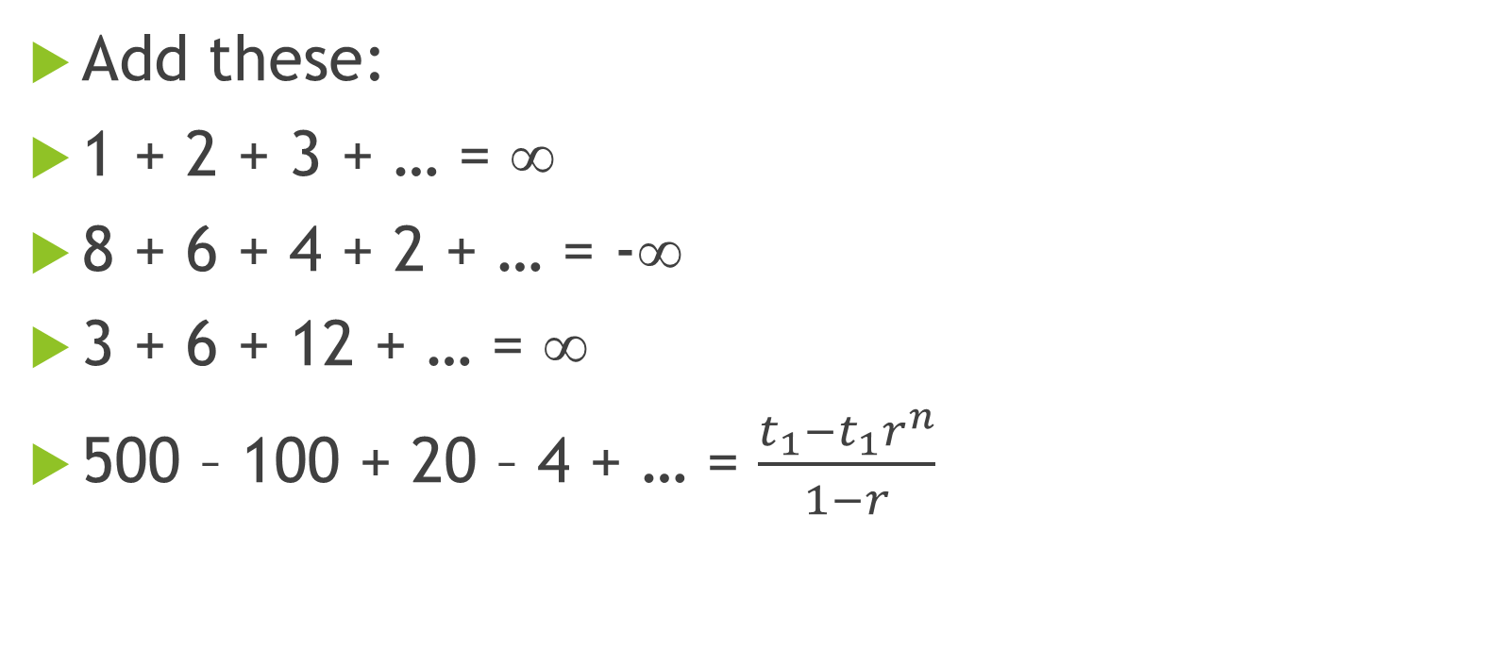
Infinite Series
Add these:
1 + 2 + 3 + … = ∞
8 + 6 + 4 + 2 + … = -∞
3 + 6 + 12 + … = ∞
500 – 100 + 20 – 4 + … = $\frac{t_{1}−t_{1}r^{n}}{1−r}$

Slide 10
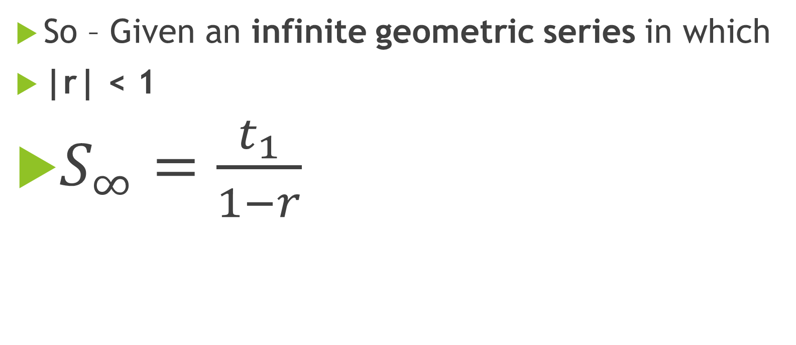
Infinite Series
So – Given an infinite geometric series in which
|r| < 1
$S_{∞}=\frac{t_{1}}{1−r}$

